Slide 1
Joint Modeling of Stress and Survival in Patients with Advanced Non-Small Cell Lung Cancer
Nicole A. Arrato, MA
The Ohio State University

Slide 2
Background
Lung cancer: highest psychological disability
Understood: baseline stress → continued distress, shorter survival
Hypothesis: Patients’ trajectories of stress after baseline will adversely impact their psychological well-being and survival

Slide 3
Methods
N=157 patients with stage IV NSCLC
Completed Impact of Events Scale-Revised (cancer stress)
Baseline and monthly through 24 months
Survival monitored
Joint statistical models
Longitudinal modeling (psychological)
Time-to-event modeling (survival)
Control variables: age, sex, smoking status, cancer type,
treatment received, marital status, education

Slide 4
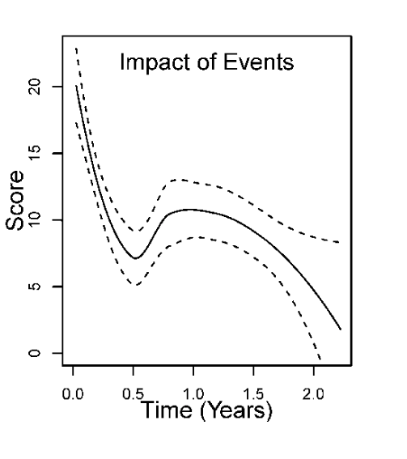
Key Results
Stress significantly with time since diagnosis
Non-linear:
Increases at 6 months
Decreases at 12 months
Covariates: Education significantly associated
High school education or above → less stress
IES-R scores not significantly associated with survival

Slide 5
Take-Home Messages
From diagnosis to 2-years, stress may decrease in a non-linear fashion, with a ”spike” around the 6-month time point
Patients with less than a high school education may be at risk for higher stress during lung cancer treatment
Future research needed

Slide 6
Contact Information
Nicole A. Arrato, MA
The Ohio State University
Arrato.1@osu.edu

