Slide 1
Depression and Anxiety as Predictors of Reactions to the COVID-19 Pandemic in Patients with Advanced Non-Small Cell Lung Cancer
Clarence Coker, BS
The Ohio State university
Society for Behavioral Medicine 2021 annual meeting

Slide 2
Background and Introduction
Anxiety and Depression play significant roles determining disease outcome in patients with advanced lung cancer (NSCLC)
Illness-Related Stress also has an indirect effect on disease outcomes through sickness behavior
The mental consequences of the COVID-19 Global Pandemic among vulnerable communities are yet to be fully explored
Notes:
Anxiety and depression are prevalent among patients with advanced non-small-cell lung cancer (NSCLC) and predict adverse psychological and disease-related outcomes.
In addition to these, illness-related stress plays a significant role in influencing sickness behaviors, leading to worse disease-related outcomes
The global pandemic caused by the severe acute respiratory syndrome coronavirus 2 (SARS-CoV-2) has far-reaching physical and mental consequences that have yet to be explored.
Little is known about how vulnerable populations have reacted to the unprecedented environment that exists as a result of the pandemic.

Slide 3
Hypothesis and study aim
The current study investigates the role played by anxiety and depressive symptoms in reactions to the global pandemic in patients with NSCLC
Hypothesis
Patients with higher anxious or depressive symptoms will experience significantly higher levels of stress during isolation while exhibiting poorer safety

Slide 4
methods
Patients with advanced NSCLC (N = 76) completed measures of:
Depression: Patient Health Questionnaire (PHQ-9)
Anxiety: Generalized Anxiety Disorder Scale (GAD-7)
COVID Illness Perceptions: Brief Illness Perceptions Questionnaire (BIPQ)
Social Distancing Efficiency and Stress During Isolation
Statistical Analyses
Multivariate Linear Regressions controlling for baseline values of predictors
Notes:
A repeated measures design was used.
Multivariate linear regression analyses predicted responses to items from patients’ depression and anxiety scores at time of COVID-19 assessment, controlling for depression/anxiety at baseline (initial cancer diagnosis)

Slide 5
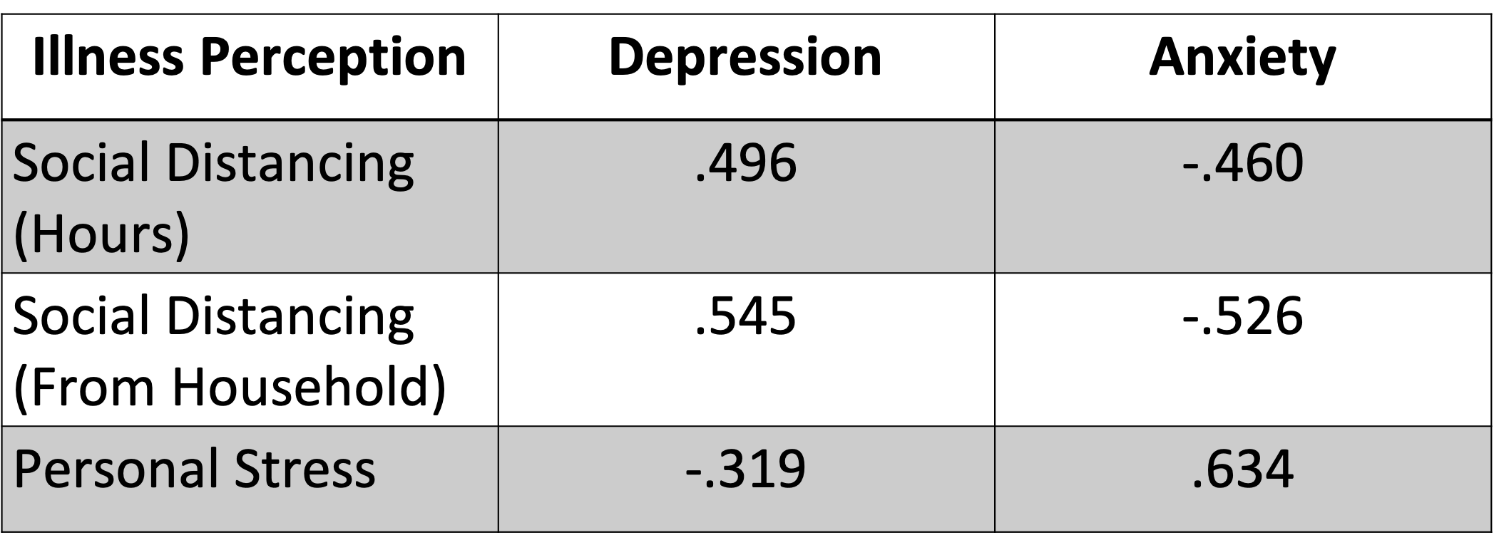
results
Table 2. Effect sizes from linear regression analyses testing Depression and Anxiety responses at the beginning of the pandemic to predict responses to BIPQ items, controlling for baseline values of the predictors (ps < .04)
Notes:
Anxiety and Depression at baseline (initial cancer diagnosis) did not predict responses to any of the items
Anxiety and Depression at the start of the pandemic predicted efficiency of social distancing.
Anxiety and Depression at the start of the pandemic predicted also predicted stress levels during the initial period of isolation

Slide 6
conclusions
Patients high in anxiety spent less time at home, were less successful in social distancing from other household members and were more stressed than other patients
Patients high in depression were more successful in social isolation and reported lower levels of stress than other patients
Notes:
These results indicate that at-risk individuals who are high in anxiety or depression reacted differently to the pandemic, according to their symptoms. These different reactions could potentially putting them at risk of being adversely affected by the pandemic

