Slide 1
Joint Modeling of Stress and Survival in Patients with Advanced
Non-Small Cell Lung Cancer
Nicole A. Arrato, MA
The Ohio State University
USA

Slide 2
Disclosures
I do not have any relevant financial relationships to disclose.

Slide 3
Background
Lung cancer: highest psychological disability
Understood: baseline stress → continued distress, shorter survival
Does psychological stress thereafter add to mortality risk?

Slide 4
Present Study
Newly diagnosed with stage IV NSCLC → observational cohort study
Joint models
Hypothesis: Patients’ trajectories of stress will adversely impact their psychological well-being and survival
--Above any contribution of demographic characteristics, stress at
diagnosis, prognostic variables, and treatment received

Slide 5
Methods
N=157 patients with stage IV NSCLC
Enrolled in NCT03199651
At diagnosis, completed ASCO-recommended measure for cancer stress
--Impact of Events Scale-Revised (IES-R)
Reassessed every 1-4 months through 24 months
Survival monitored

Slide 6
Methods
Joint statistical models
Accounted for potentially informative censoring
Provided simultaneous modeling of two processes
--Longitudinal (psychological)
--Time-to-event (survival)
Control variables: age, sex, smoking status, cancer type, treatment received, marital status, education

Slide 7
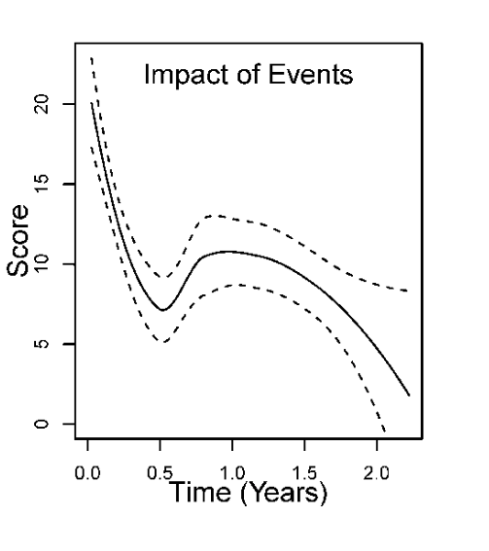
Key Results
Stress significantly decreased with
time since diagnosis
--IES-R scores decreased 16.9 → 11.1
Non-linear:
Increases at 6 months
Decreases at 12 months
LOESS (locally estimated scatterplot smoothing) smoothed changes over time in stress (IES-R) from N=157 patients. Dashed lines indicate 95% confidence intervals.

Slide 8
Key Results
Interactions between time and cancer treatment: non-significant
--No difference in trends in stress due to cancer treatment
Covariates: Education significantly associated
--High school education or above → less stress
--7-8 points lower mean IES-R scores
IES-R scores not significantly associated with survival

Slide 9
Conclusions
First study to describe course of stress for patients with advanced NSCLC as they receive new cancer therapy
More frequent IES-R → significant associations with survival?
Future research needed
--To fully understand psychological risk factors for premature
mortality from NSCLC

Slide 10
Take-Home Messages
From diagnosis to 2-years, stress may decrease in a non-linear fashion, with a ”spike” around the 6-month time point
Patients with less than a high school education may be at risk for higher stress during lung cancer treatment
Future research needed re: psychological risk factors for premature NSCLC mortality

Slide 11
Acknowledgments
I would like to acknowledge the patients who made this research possible, the Principal Investigator Dr. Barbara L. Andersen,
and the very talented biostatisticians Dr. Guy Brock
and Dr. Joseph McElroy.
Nicole A. Arrato, MA
Nicole.Arrato@osumc.edu

